Slide 1
How to Enter CHAF Boost Points / Local Input

Slide 2

Go to the Local Input Edit Screen
Click the number on Local Input tile

Slide 3
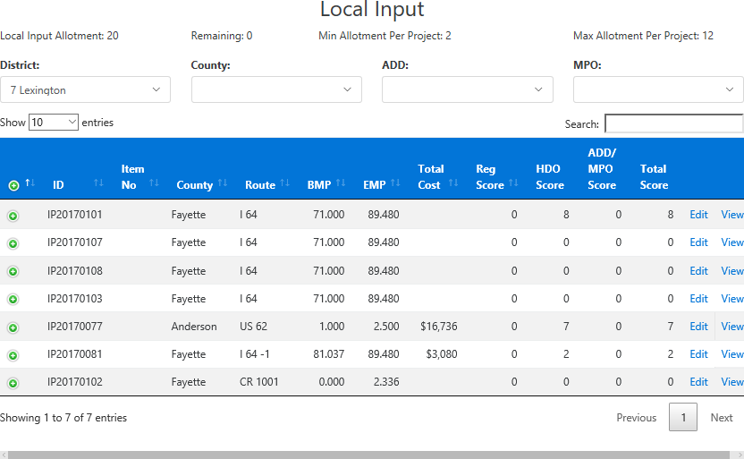
Edit Project Boosts (Local Boosts)
Click on the project to edit.

Slide 4
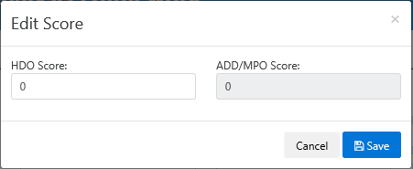
Enter Project Boosts (Local Boosts)
Enter Boost Points.
Either 15 or 0.
2. Click to save.

